Slide 1

S-101
Validation Checks

Slide 2
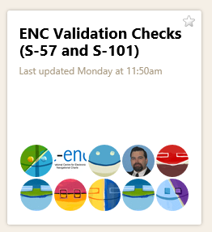
S-101 Validation Checks
At the 2017 ENCWG2 meeting in Genoa, Denmark undertook to lead on the review of the current S-58 validation checks and assess their relevance for S-101 data.
The starting point for this work was to
establish an online platform (basecamp)
to ease communication between contributors.
Currently 41 contributors

Slide 3
S-101 Validation Checks
,mn
The first comments from other PT members have been:
To separate the checks into general S-100 data format checks and S-101 product specific checks (this proposal has been submitted at the S-100WG3 meeting, and approved);
To re-group the checks according to the sections of the S-100/S-101 documents they correspond to;

Slide 4
S-101 Validation Checks
This work is an ongoing process, since many checks might have to be reviewed when the S-101 PS is finalized and full production datasets are created.
We have been looking into each S-58 check and accessing if changes are needed due to differences between the S-57 UOC and the S-101 DCEG, as well as the main documents.
Changes to the attribution are more clear to us but, in the ones related to data structure, we would more than welcome expert input.

Slide 5
S-101 Validation Checks
In general most of the checks can be kept with only a wording review.
Others need to be changed due to changes in feature attributes from S-57 to S-101.
The ones related to associations need a major change since these are completely different in S-101. They might suffer further adjustments.
All the references to the chapters need to be re-checked since the S-101 Ed.1 document has different chapter number than the previous versions.

Slide 6
S-101 Validation Checks
What Now?
Collect suggestions from the contributors regarding:
Identifying the S-100 only checks, and removing them;
Agree a grouping structure for the remaining S-101 checks;
Identify any possible new checks that need to be added to the list.
Re-check all the references according to the latest S-101 version.
Find volunteers to help with the above.

